Slide 1
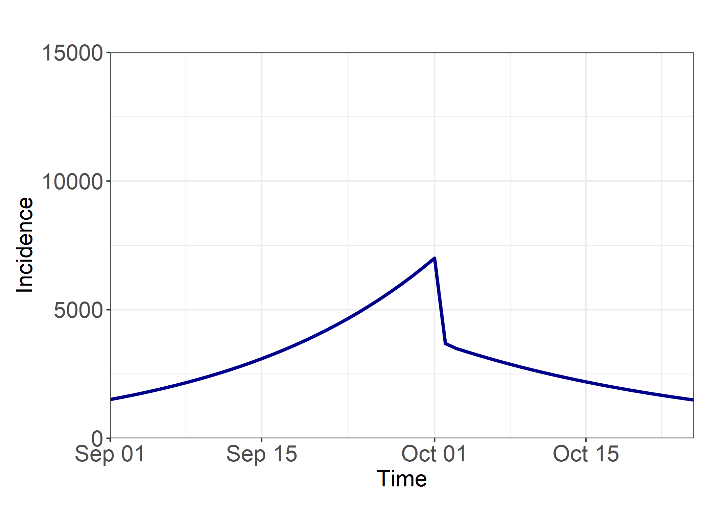
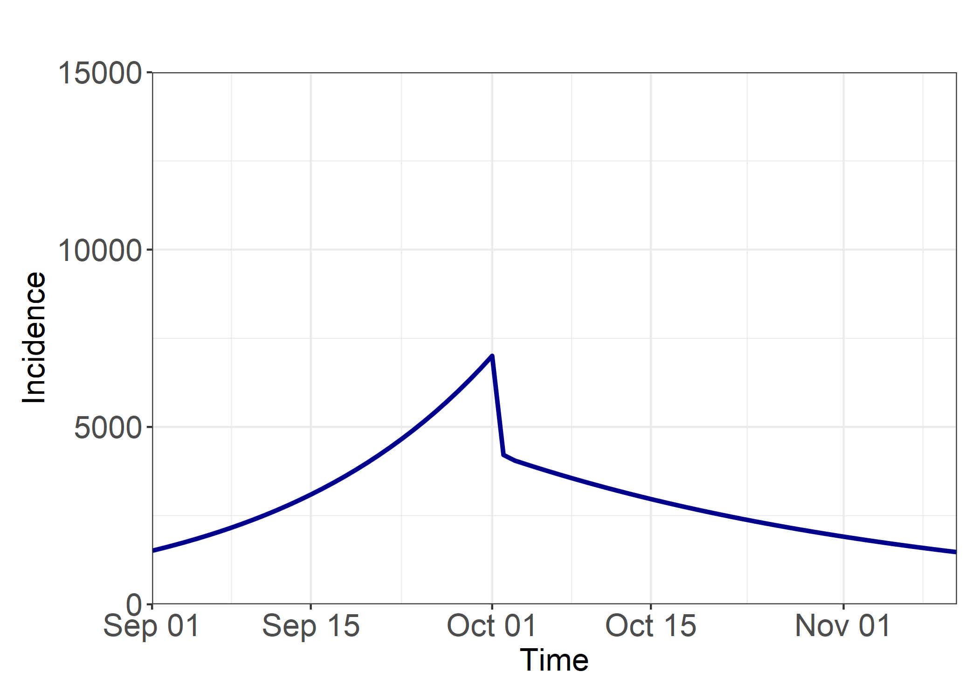
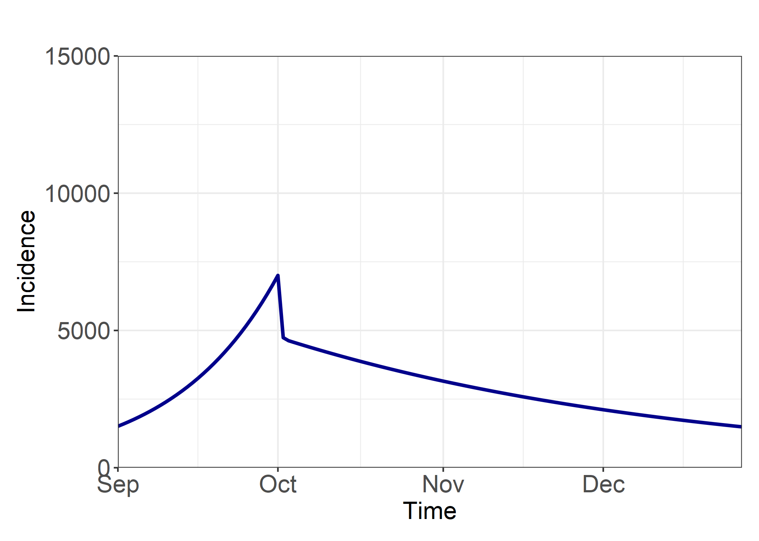
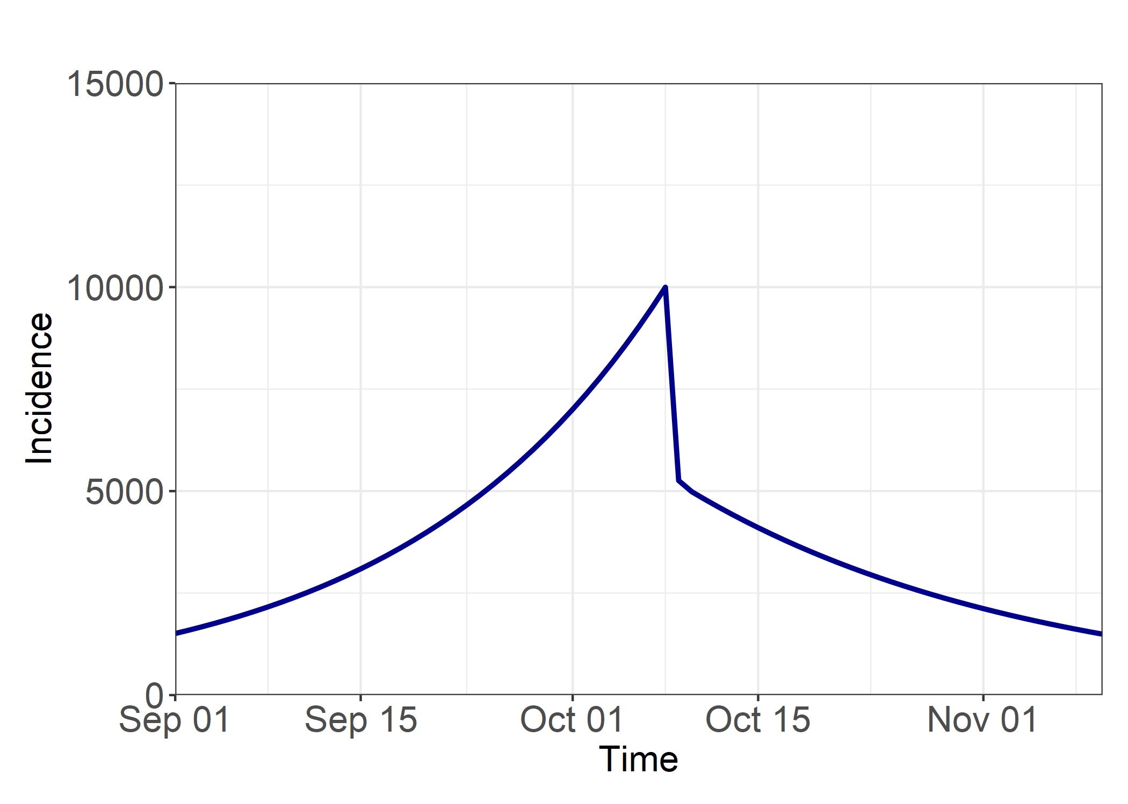
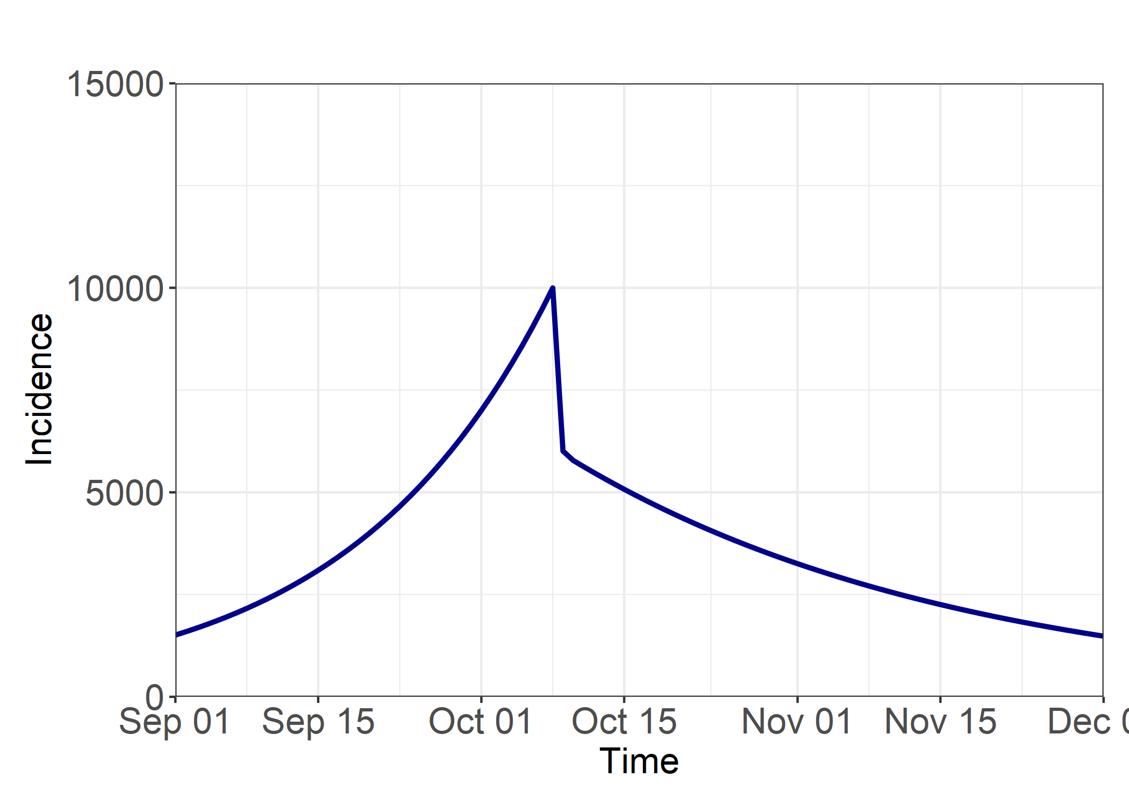
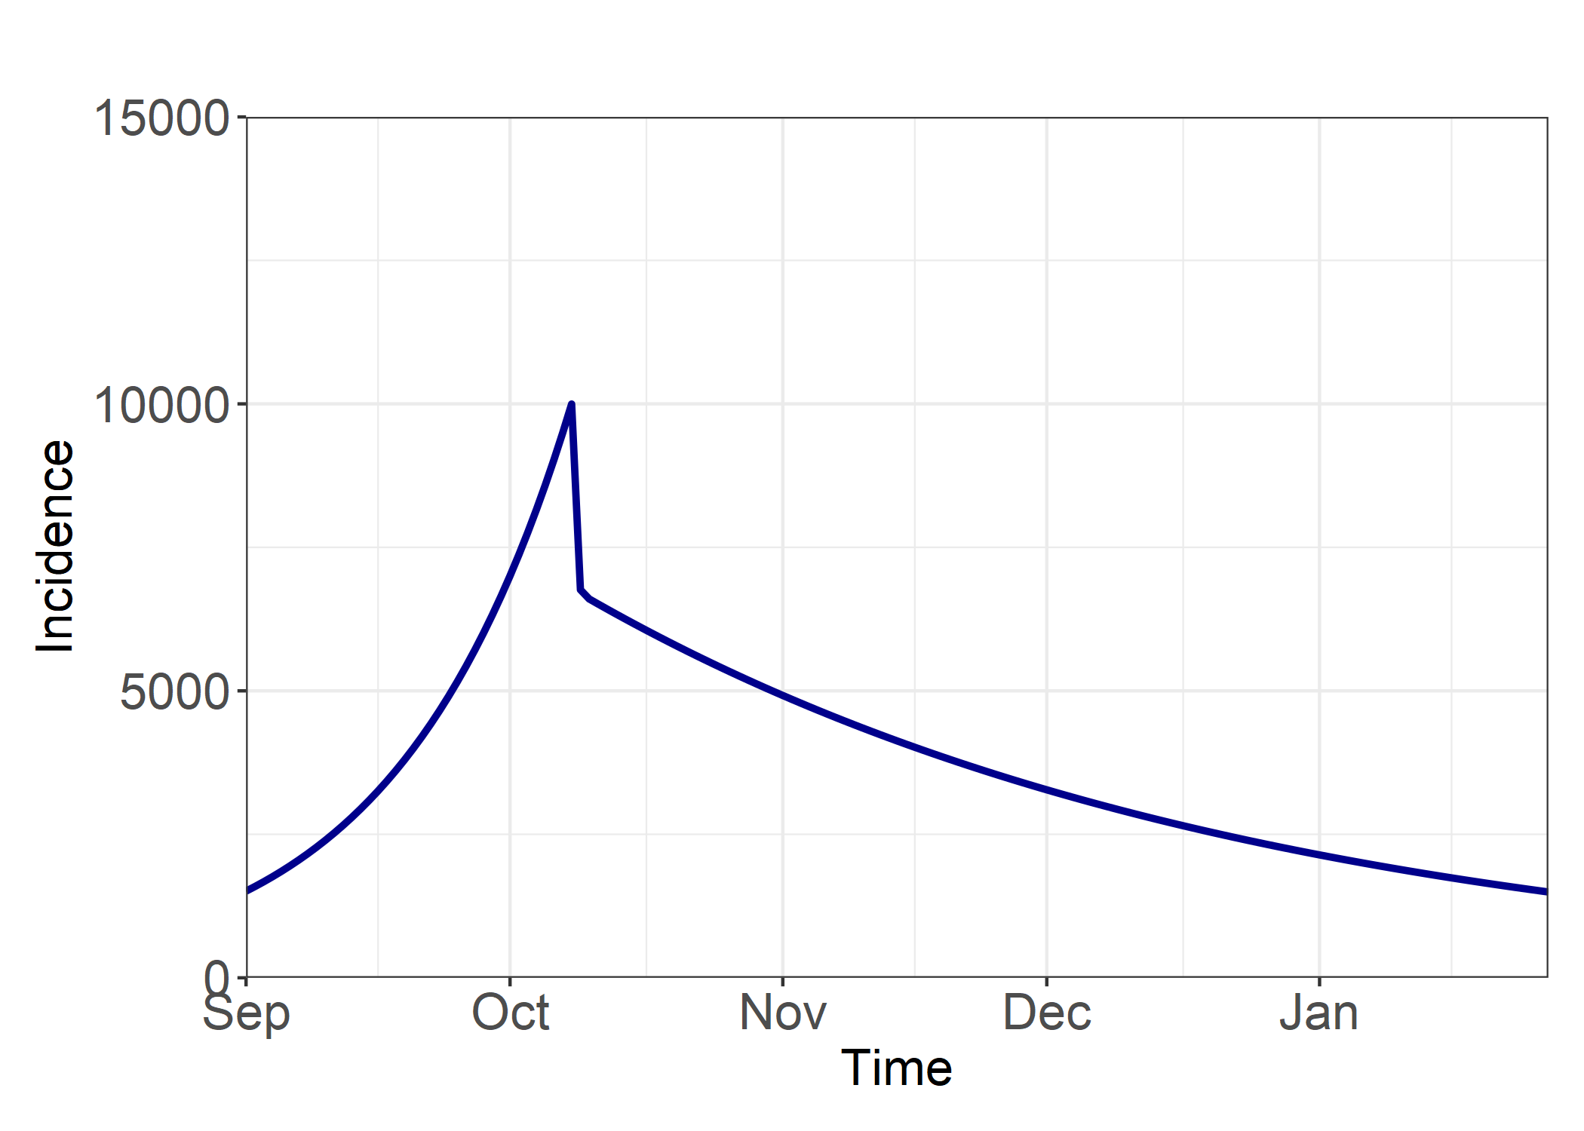
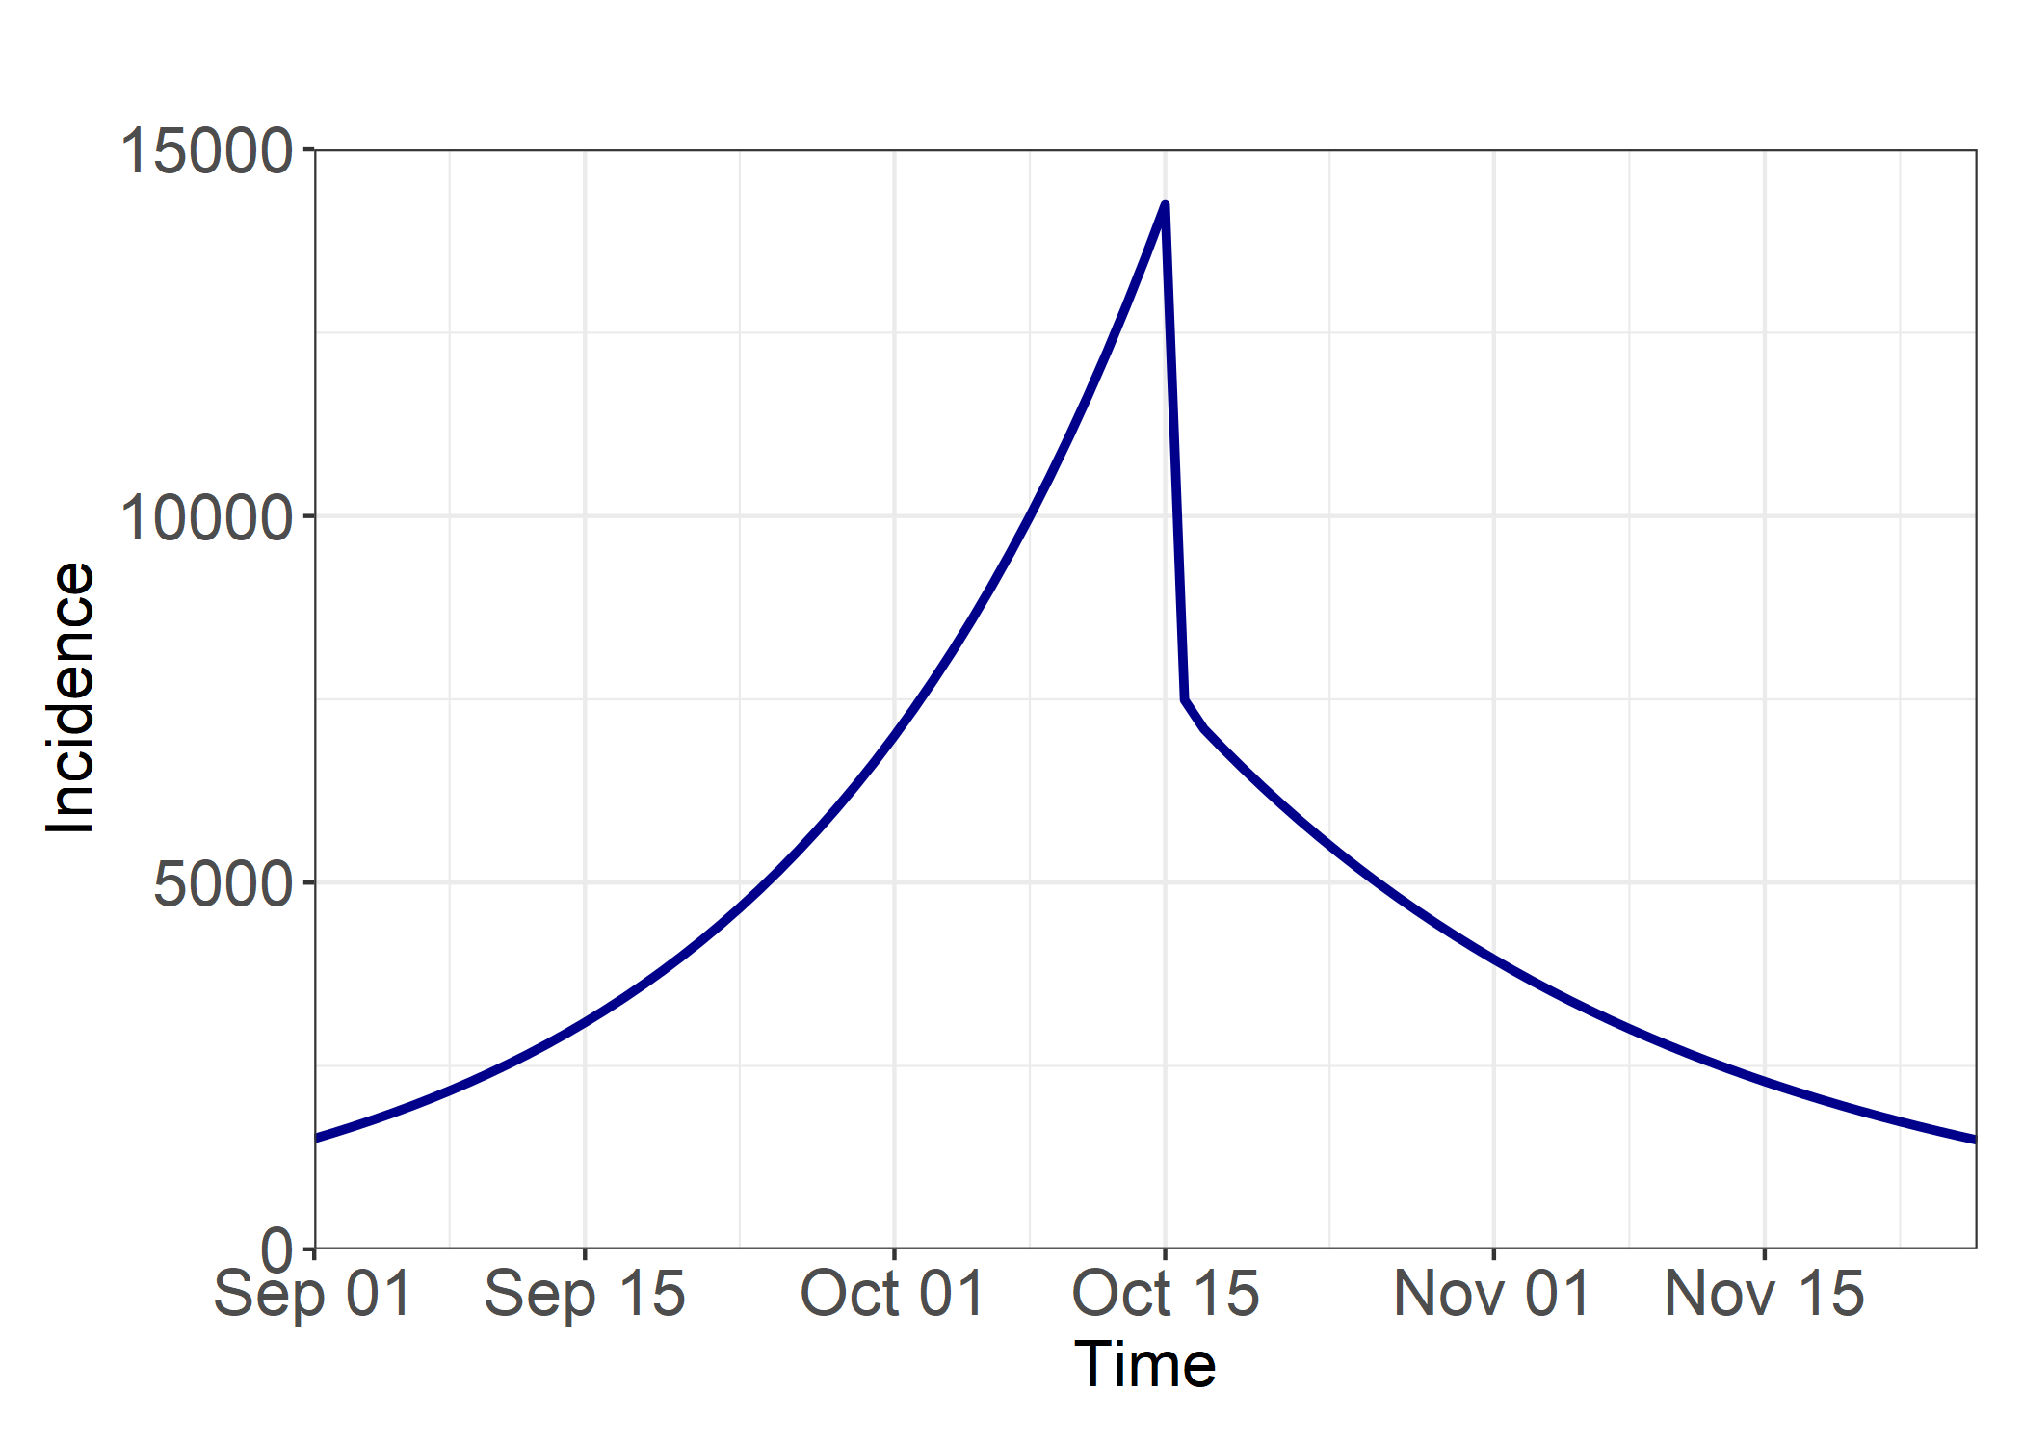
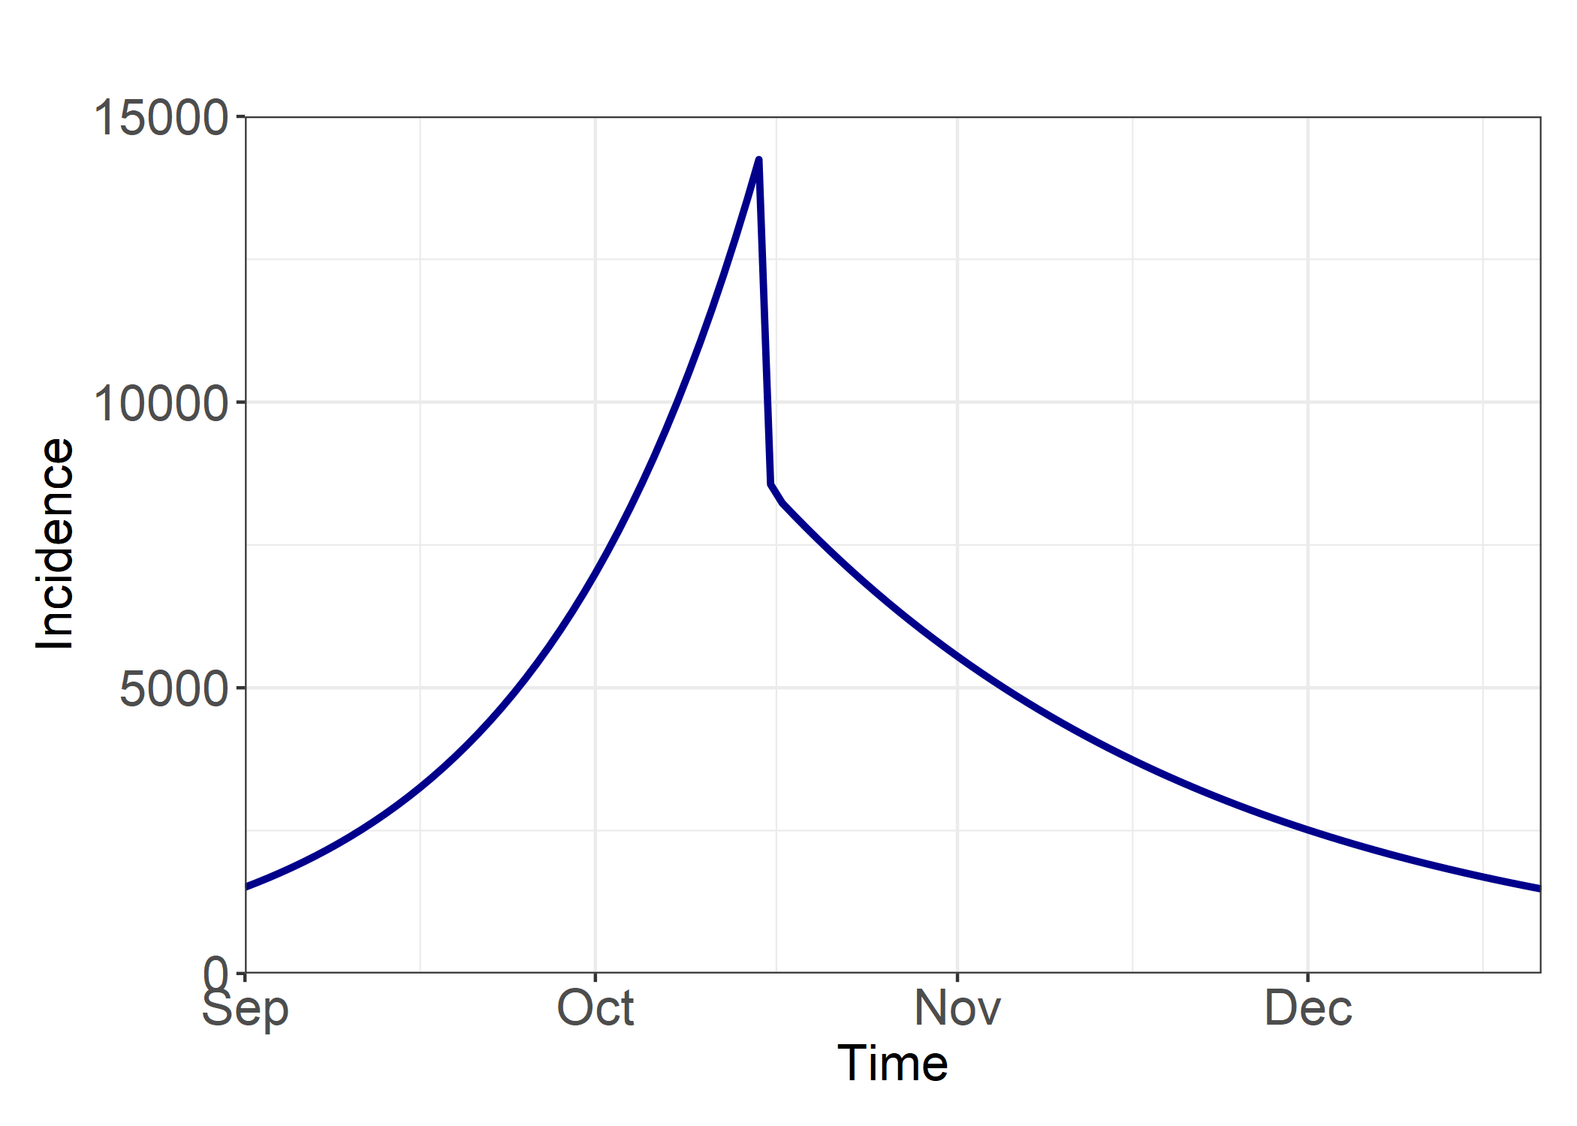
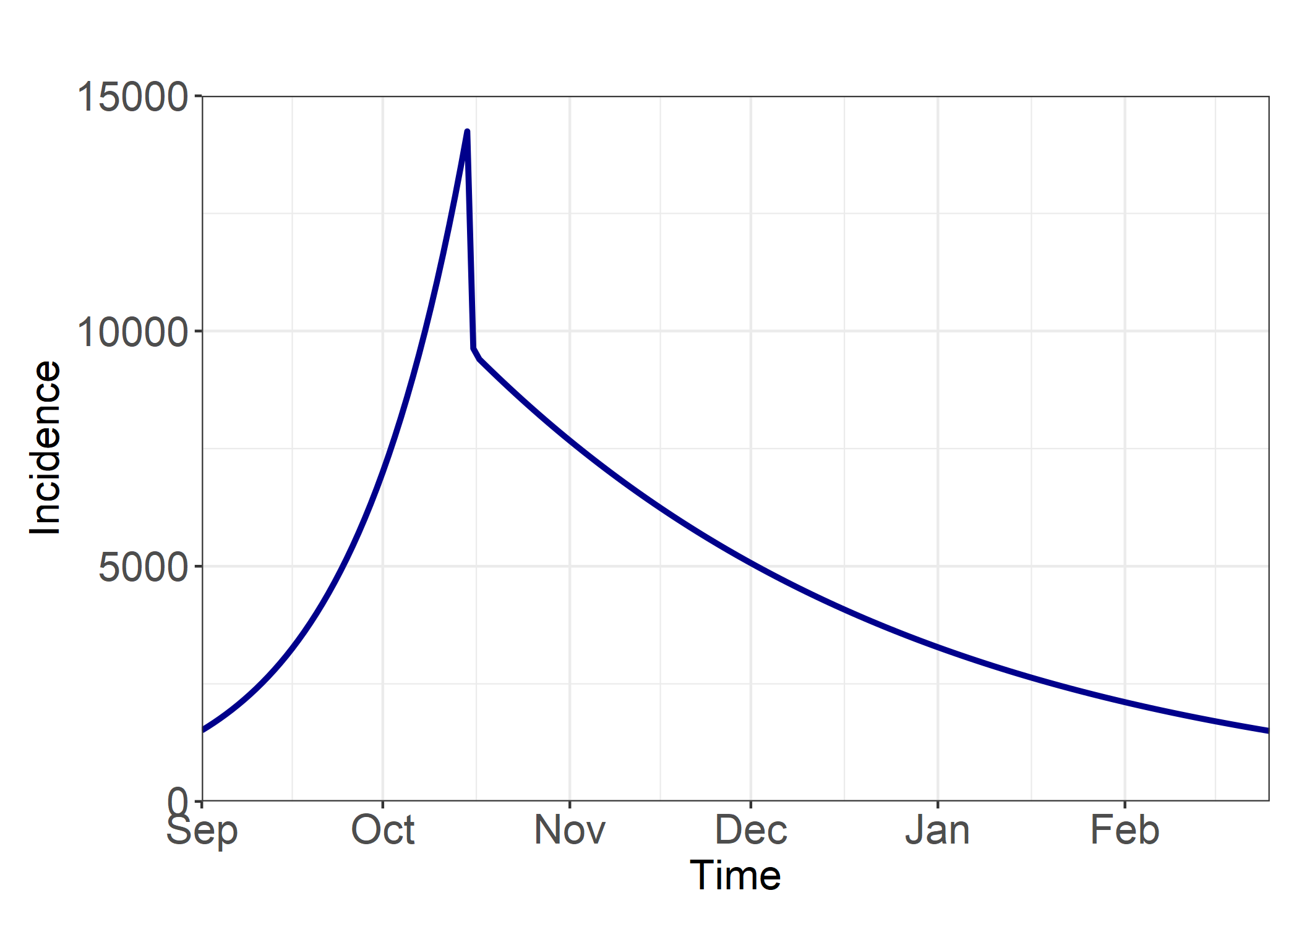
Post Intervention R = 0.7
Post Intervention R = 0.8
Post Intervention R = 0.9
Intervention Delay = 0 Days
A) Total Infections from 01/09/20 = 169628
B) Total Infections from 01/10/20 = 57865
B/A = 0.34
A) Total Infections from 01/09/20 = 218045
B) Total Infections from 01/10/20 = 106282
B/A = 0.49
A) Total Infections from 01/09/20 = 355272
B) Total Infections from 01/10/20 = 243509
B/A = 0.69
Intervention Delay = 7 Days
A) Total Infections from 01/09/20 = 270408
B) Total Infections from 01/10/20 = 158646
B/A = 0.59
A) Total Infections from 01/09/20 = 346125
B) Total Infections from 01/10/20 = 234363
B/A = 0.68
A) Total Infections from 01/09/20 = 559498
B) Total Infections from 01/10/20 = 447736
B/A = 0.80
Intervention Delay = 14 Days
A) Total Infections from 01/09/20 = 413666
B) Total Infections from 01/10/20 = 301903
B/A = 0.73
A) Total Infections from 01/09/20 = 527679
B) Total Infections from 01/10/20 = 415916
B/A = 0.79
A) Total Infections from 01/09/20 = 841744
B) Total Infections from 01/10/20 = 729981
B/A = 0.87

Slide 2
Post Intervention R = 0.7
Post Intervention R = 0.8
Post Intervention R = 0.9
Intervention Delay = 0 Days
A) Total Infections from 01/09/20 = 169628
B) Total Infections from 01/10/20 = 57865
B/A = 0.34
A) Total Infections from 01/09/20 = 218045
B) Total Infections from 01/10/20 = 106282
B/A = 0.49
A) Total Infections from 01/09/20 = 355272
B) Total Infections from 01/10/20 = 243509
B/A = 0.69
Intervention Delay = 7 Days
A) Total Infections from 01/09/20 = 270408
B) Total Infections from 01/10/20 = 158646
B/A = 0.59
A) Total Infections from 01/09/20 = 346125
B) Total Infections from 01/10/20 = 234363
B/A = 0.68
A) Total Infections from 01/09/20 = 559498
B) Total Infections from 01/10/20 = 447736
B/A = 0.80
Intervention Delay = 14 Days
A) Total Infections from 01/09/20 = 413666
B) Total Infections from 01/10/20 = 301903
B/A = 0.73
A) Total Infections from 01/09/20 = 527679
B) Total Infections from 01/10/20 = 415916
B/A = 0.79
A) Total Infections from 01/09/20 = 841744
B) Total Infections from 01/10/20 = 729981
B/A = 0.87

Slide 3
Methodology
Outcome Measures
Cumulative incidence from the beginning of simulation (01/09/20) until incidence goes back to 1500 cases.
Cumulative incidence from 01/10/20 until incidence goes back to 1500.
Ratio of B/A
Sensitivity Analysis
We explore a delay to the intervention of 0/7/14 days.
Post-intervention β is defined using R = 0.9/0.8/0.7.
Model structure – Standard SIR model
Initial Conditions
S = 66,641,600
I = 8,400
R = 0
Parameter Values
β = 0.1797 (Using R = 1.4)
γ = 0.1284
Parameter values and initial conditions chosen so that:
At the start of the model simulation (t = 0) set at 01/09/20 the incidence is 1500 cases.
At 01/10/20 (t = 30) the incidence is 7000 cases
At baseline, the model Intervention is triggered the day after 1st October (t = 31).

